Slide 1

Department of Computer Science and Engineering Enhanced Lung Cancer Detection Using Deep Learning Ensemble Approach PRESENETED BY
Ainavolu Manvitha (21471A0572)
Dokku Naga Revathi (21471A0581)
Kasula Prathima (21471A0595)
Under the Guidance of,
Dr. Sireesha Moturi
Associate Professor
Department of Computer Science and Engineering,
Narasaraopeta Engineering College (Autonomous),
Narasaraopeta- 522 601.

Slide 2
OUTLINE
Abstract
Introduction
Literature Survey
Research Gaps
Problem Statement
Objectives
Block Diagram / FlowDiagram
Methodology
Implementation
Results and Analysis
Conclusion & Future Scope
References
Question and Answers
Acknowledgements

Slide 3
ABSTRACT
In emerging technologies, deep learning has become the solution for most real-world problems. This is used by integrating with computer science and predicting many diseases for people at an early stage. One of the major issues is the detection of Lung Cancer either Cancerous or Non-Cancerous. Many studies have proposed solutions to detect lung nodules. However, using an ensemble approach by taking CT(Computed Tomography) Scan images gives accurate results compared to other methodologies. In this study, we proposed the methodology by combining three deep learning models instead of one. Thereby, the performance of three CNN models is combined to get accurate results. The dataset used for this is LUNA16 from Grand Challenge which is available online. This dataset consists of CT scans and an annotations file which gives the information about each CT Scan. Our Ensemble 2D CNN model gave an effectiveness of 96% greater than the baseline methodology.

Slide 4
INTRODUCTION
Lung cancer is one of the most dangerous cancers, causing a large number of deaths worldwide. Early detection is crucial as it can save lives by enabling timely treatment.
The main aim is to use deep learning techniques to develop a system for accurate and quick lung cancer prediction.
The medical images are visualized under 3D view to analyze clearly. So to handle these type of images needs to be efficient in identifying them. DL approaches introduce Neural networks which will learn the patterns of images in all dimensions.
Advanced models like 2D CNNs are used to process medical images more effectively. The system offers healthcare professionals a faster and more reliable diagnostic tool.
The LUNA16 dataset from the Grand Challenge is chosen for training and evaluation.
Ensemble learning is incorporated to combine multiple CNN models, improving overall prediction accuracy and robustness.

Slide 5
LITERATURE SURVEY
No | Title | Author | Journal Name & Year | Methodology Adapted | Key Findings | Gaps
1 | Deep learning techniques to diagnose lung cancer | Wang, L | Cancers, 2022 | 3D Convolutional Neural Networks (3D CNN) for lung cancer diagnosis | clinicians can detect and classify lung nodules more accurately and quickly. | Using a large number of inaccurate, data
2 | Deep learning-based algorithm for lung cancer detection on chest radiographs using the segmentation method | Akitoshi Shimazaki, et al | Scientific Reports , 2022 | DL-based model with five-fold cross-validation. | DL-based model had a sensitivity of 0.73 with 0.13 mFPI in the test dataset | This may reduce the detection rate of benign nodules/masses.
3 | Using 2D CNN with Taguchi Parametric Optimization for Lung Cancer Recognition from CT Images | Cheng-Jian Lin, et al | ResearchGate, 2020 | 2D convolutional neural network (2D CNN) with Taguchi parametric optimization | The proposed method is 6.86% and 5.29% more accurate than the original 2D CNN on the two datasets, respectively. | The limitation of this study is the depth of layers.

Slide 6
LITERATURE SURVEY
No | Title | Author | Journal Name & Year | Methodology Adapted | Key Findings | Gaps
4 | An ensemble deep learning model for risk stratification of invasive lung adenocarcinoma using thin-slice CT | Jing Zhou, et al | Digital Medicine, 2023 | an ensemble multi-view 3D convolutional neural network (EMV-3D-CNN) model | It provides detailed predictive histological information for the surgical management of pulmonary nodules. | more samples should be collected and used to perform comprehensive external validation
5 | Lung Cancer Detection and Classification Using Deep Learning | Ruchita Tekade, et al | International Conference on Computing Communication Control and Automation (ICCUBEA), 2018 | 3D multipath VGG-like network, which is evaluated on 3D cubes. | The lung nodules are classified and malignancy level is detected using this architecture with 95.60% of Accuracy | Lack of comparisons with state-of-the-art and complex to test on real-world applications.

Slide 7
RESEARCH GAPS
Many studies depend heavily on large datasets, but inaccuracies in data can affect model reliability and robustness.
Accurate differentiation between benign and malignant nodules remains a challenge, impacting detection rates.
Limited depth in CNN architectures restricts the ability to extract complex features, which is crucial for improving classification performance.
Existing models often lack large-scale external validation, reducing their applicability to real-world clinical scenarios.
Class imbalance in datasets is inadequately addressed, leading to biased predictions and lower sensitivity for minority classes.

Slide 8
PROBLEM STATEMENT
Early and accurate detection of cancerous nodules in lung CT scans can significantly improve patient outcomes. However, existing diagnostic methods face challenges such as high false-positive rates, lack of automation, and inefficiency in handling large datasets. The need arises to develop an automated, accurate, and efficient solution to detect lung cancer at its early stages using advanced deep learning techniques, focusing on ensemble 2D Convolutional Neural Networks (CNNs) to improve classification accuracy while addressing class imbalance and optimizing computational performance.

Slide 9
OBJECTIVES
Develop an automated deep learning system to detect lung cancer at an early stage. The approach addresses the challenges of identifying subtle patterns in CT scans. This aims to improve patient outcomes by enabling timely intervention.
Combine three distinct CNN architectures for better accuracy and robustness. The ensemble approach reduces misclassifications by leveraging diverse feature extraction. Soft voting is applied to aggregate predictions for reliable results.
Utilize the LUNA16 dataset with advanced preprocessing techniques to improve input data quality. Convert raw CT images into usable formats and normalize them for effective model training. This ensures consistent and high-quality data analysis.
Introduce focal loss to counteract dataset imbalances between cancerous and non-cancerous classes. This minimizes bias and ensures the model learns patterns effectively across all categories. Enhanced loss functions lead to fair and accurate predictions.

Slide 10
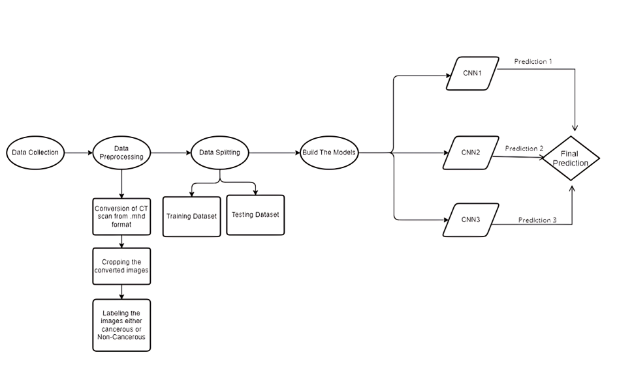
BLOCK DIAGRAM

Slide 11
METHODOLOGY
Data Collection: Utilized the LUNA16 dataset, containing CT scan images of lung nodules in .mhd format.
Preprocessing: Converted .mhd images to .jpg using SimpleITK for easier handling.
Model Development: Implemented an ensemble method combining three distinct 2D CNN models.
Ensemble Prediction: Combined predictions from all three models to improve accuracy.

Slide 12
METHODOLOGY
Data Collection
The LUNA16 dataset, sourced from the LIDC/IDRI database, was used, containing 1,018 CT scans annotated by four experienced radiologists.
Nodules were categorized into three types: nodules ≥ 3 mm, nodules < 3 mm, and non-nodules, ensuring comprehensive coverage of nodule variations.
Included supplementary files such as annotations.csv (reference annotations), sampleSubmission.csv (example submission format), candidates.csv (candidate sites), and segmentation data.
A 10-fold cross-validation setup was employed to ensure the model's generalization and to validate results across multiple subsets.

Slide 13
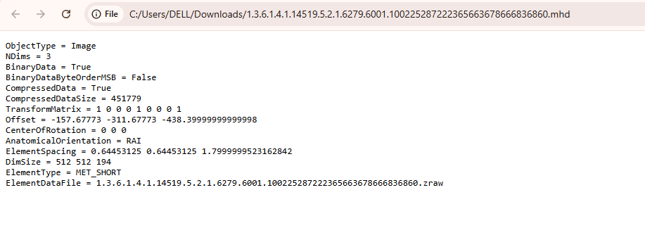
METHODOLOGY
Fig: The image shows the data inside .mhd file.
The .zraw files, often accompanied by .mhd metadata files, cannot be directly viewed manually as they store raw medical imaging data in binary format. However, these files can be visualized by processing and converting them into a readable format using Python libraries like SimpleITK. The .mhd file contains essential information about the image dimensions,data type, and spacing, which allows libraries like SimpleITK to correctly interpret and load the .zraw data for further analysis or visualization.

Slide 14
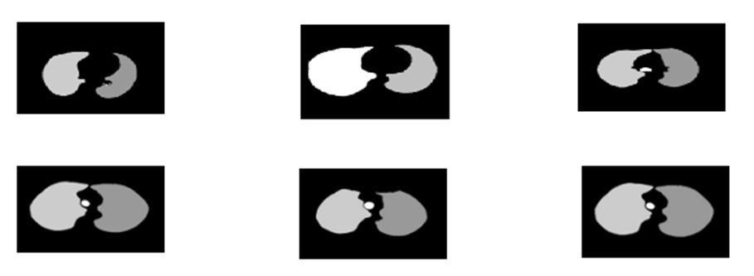
METHODOLOGY
Data Preprocessing:
The dataset utilized in this paper is the LUNA16 dataset sourced from Grand Challenge 2016. This dataset contains data about lung cancer with the CT scan images in .mhd format.
.mhd files contain image resolution, pixel spacing, and data type metadata. This information correctly interprets the associated .raw file, which contains the raw pixel data.
This is done with libraries such as SimpleITK. The images after converting from .mhd to JPEG format are visualized, and Figure shows the images .
Fig: CT Scan Images after converting from .mhd

Slide 15
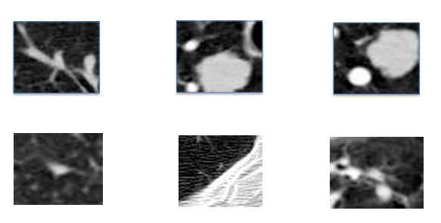
METHODOLOGY
Data Preprocessing
Once the image is reconstructed, the image can be saved in .JPEG format using a standard image processing library PIL (Python Imaging Library).After converting the images from MHD to JPEG format and applying normalization.
The images in JPEG format are cropped in the region based on the coordinates given in the annotations.csv file, which gives information about each CT scan. Figure 2 shows the preprocessed images.
Fig: CT Scan images after pre-processing

Slide 16
METHODOLOGY
Splitting the Dataset
LUNA16 dataset split into training and testing sets based on the class column (1: cancerous, 0: non-cancerous).
Instead of organizing the data into separate subfolders for "Cancerous" and "Non-Cancerous," the dataset was directly divided into two folders:
Train: Used for training the model to learn from the data.
Test: Used to evaluate the model's accuracy and prediction capabilities.

Slide 17
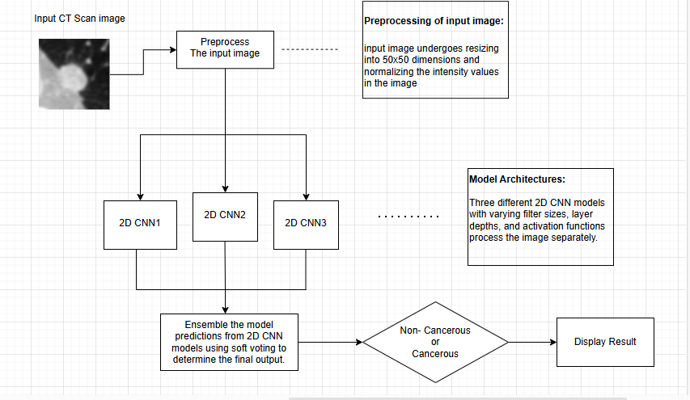
METHODOLOGY
Building the Model Architecture
An ensemble model of three 2D CNNs enhances feature extraction and classification accuracy.
Fig: Design Overview Of Implementation

Slide 18

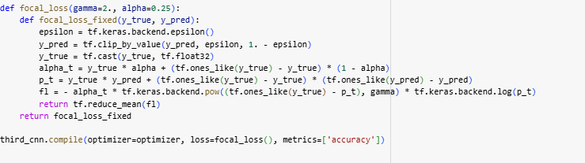
METHODOLOGY
Focal Loss Function:
An improved version of Cross-Entropy Loss for handling class imbalance.
Reduces weight for easily classified examples, emphasizing harder ones.
Enhances learning from rare classes like cancerous samples.

Slide 19
METHODOLOGY
The elements in focal loss function are explained below:
gamma (Focusing Parameter): Controls the strength of down-weighting for well-classified examples.If gamma = 0, the loss is equivalent to Cross-Entropy Loss. Higher values focus more on hard misclassified samples.
alpha (Class Weighting Factor): Adjusts the weight assigned to each class, helping mitigate class imbalance. Typically set between 0 and 1 (e.g., 0.25 for the minority class).
Epsilon (ε) is a small constant used to avoid division by zero.
alpha_t: Dynamically assigns a weight:
If y_true = 1 (positive class), weight = alpha .
If y_true = 0 (negative class), weight = 1 - alpha .
Helps counter class imbalance by giving higher importance to minority classes.

Slide 20
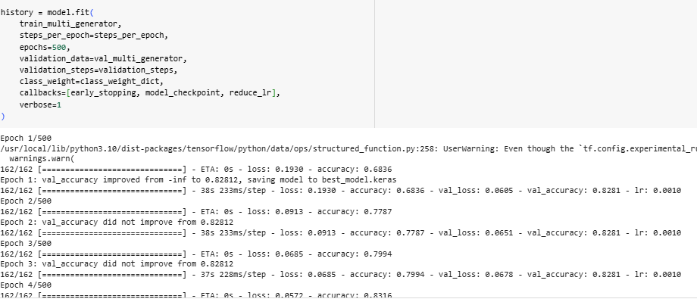
IMPLEMENTATION
Training the models:

Slide 21
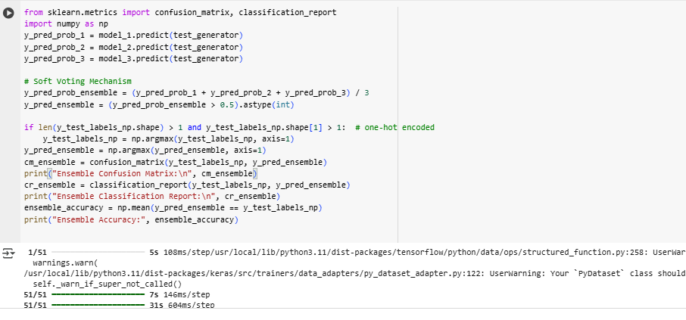
IMPLEMENTATION
Ensembling three 2D CNN model:

Slide 22
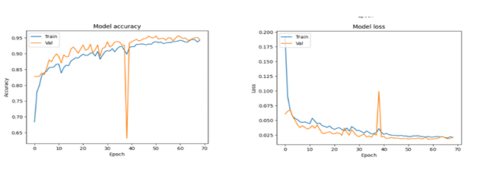
RESULTS & ANALYSIS
Results for 2D CNN Model 1
Achieved 95% accuracy after 70 epochs with strong precision for non-cancerous cases (0.98) and recall for cancerous cases (0.91).
Balanced performance reflected in an F1-score of 0.82 for the cancerous class.
Accuracy and loss curves confirm consistent convergence during training.
Fig: Accuracy and Loss Curves for 2D CNN1

Slide 23
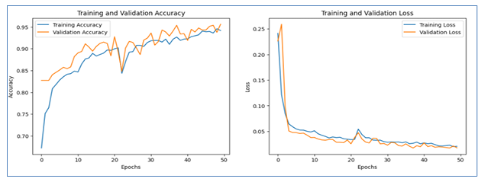
RESULTS & ANALYSIS
Results for 2D CNN Model 2
Delivered 94.91% accuracy, with high precision and recall for both cancerous and non-cancerous cases.
Slightly higher false negatives (45 cases) compared to false positives (27 cases).
Improved feature extraction attributed to deeper architecture.
Fig: Accuracy and Loss Curves for 2D CNN2

Slide 24
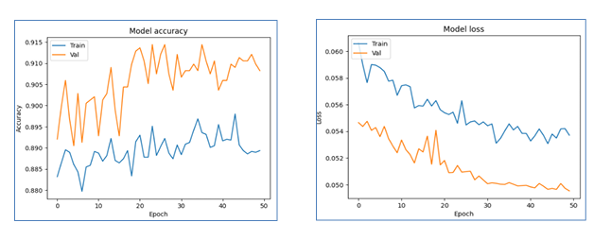
RESULTS & ANALYSIS
Results for 2D CNN Model 3
Achieved 91% accuracy after 50 epochs, balancing performance across both classes.
Diverse kernel sizes enhanced the model's ability to capture complex features.
Accuracy and loss curves indicate stable training with minimal overfitting.
Fig: Accuracy and Loss Curves for 2D CNN3

Slide 25
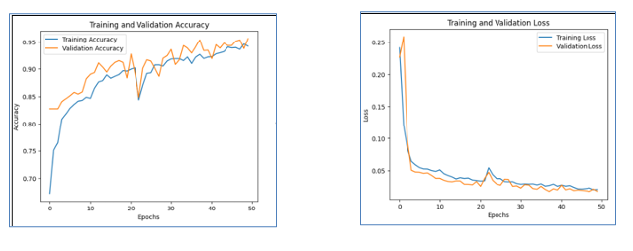
RESULTS & ANALYSIS
Results for Ensemble 2D CNN Model
Combined predictions from three models using soft voting, achieving a final accuracy of 96%.
Ensemble approach improved robustness and reduced false positives and negatives.
Precision and recall metrics highlight balanced performance across all classes.
Fig: Accuracy and Loss Curves for Ensemble 2D CNN

Slide 26
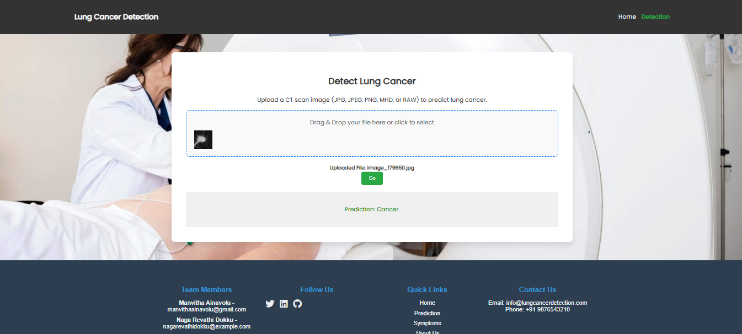
IMPLEMENTATION
Implementation of Frontend: detection Cancerous CT Scan

Slide 27
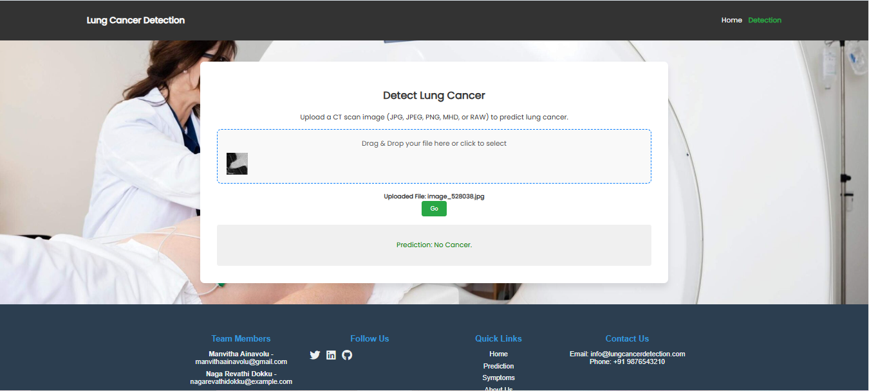
IMPLEMENTATION
Implementation of Frontend : detection Non-Cancerous CT Scan

Slide 28
CONCLUSION and FUTURE SCOPE
The proposed model achieved high accuracy, effectively detecting lung cancer using CT scan images. Ensemble learning techniques enhanced overall prediction performance.
Results demonstrated significant improvement over existing methods, showcasing the approach's robustness and reliability in medical diagnostics.
Future work includes extending the model to 3D CNNs for volumetric analysis. This could further improve accuracy and provide detailed insights into tumor growth patterns.
Integration with real-world clinical workflows and larger datasets can validate the model’s scalability. Addressing hardware limitations will ensure practical applicability.
Current limitations include dependency on preprocessed datasets and computational costs. Optimizing these aspects will enhance efficiency and adoption in clinical settings.

Slide 29
REFERENCES
[1] Wang, L. (2022). ”Deep learning techniques to diagnose lung cancer”. Cancers, 14(22), 5569., https://doi.org/10.3390/cancers14225569
[2] Heuvelmans, M. A., van Ooijen, P. M., Ather, S., Silva, C. F., Han, D., Heussel, C. P., ... & Oudkerk, M. (2021). ”Lung cancer prediction by Deep Learning to identify benign lung nodules”. Lung Cancer, 154, 14. https://doi.org/10.1016/j.lungcan.2021.01.027
[3] Li, Z., Zhang, J., Tan, T., Teng, X., Sun, X., Zhao, H., ... & Litjens, G. (2020). ”Deep learning methods for lung cancer segmentation in whole-slide histopathology images—the acdc@ lungp challenge 2019”. IEEE Journal of Biomedical and Health Informatics, 25(2), 429-440. https://doi.org/10.1109/JBHI.2020.3039741
[4] Huang, P., Lin, C. T., Li, Y., Tammemagi, M. C., Brock, M. V., Atkar Khattra, S., ... & Lam, S. (2019). ”Prediction of lung cancer risk at follow-up screening with low-dose CT: a training and validation study of a deep learning method”. The Lancet Digital Health, 1(7), e353-e362. https://doi.org/10.1016/j.lungcan.2021.01.027
[5] Subramanian, R. R., Mourya, R. N., Reddy, V. P. T., Reddy, B. N., & Amara, S. (2020). ”Lung cancer prediction using deep learning framework”. International Journal of Control and Automation, 13(3), 154-160. https://www.researchgate.net/publication/346700750
[6] Shimazaki, A., Ueda, D., Choppin, A., Yamamoto, A., Honjo, T., Shimahara, Y., & Miki, Y. (2022). ”Deep learning-based algorithm for lung cancer detection on chest radiographs using the segmentation method”. Scientific Reports, 12(1), 727. https://doi.org/10.1038/s41598 021-04667-w
[7] Lin, C. J., Jeng, S. Y., & Chen, M. K. (2020). ”Using 2D CNN with Taguchi parametric optimization for lung can cer recognition from CT images”. Applied Sciences, 10(7), 2591. https://doi.org/10.3390/app10025991

Slide 30
QUESTIONS and ANSWERS
What inspired you to choose this topic for your project?
How reliable are the results, and how were they validated?
What are the practical applications of your model in the medical field?
What limitations did you encounter, and how can they be addressed?
How does your project contribute to advancements in healthcare technology?
Can this approach be extended to predict other types of cancers or diseases?
What datasets did you use, and why were they chosen for this project?
How does your model handle variations in CT scan quality?
What techniques were used to improve the model’s performance?
How scalable is your approach for real-world clinical applications?
What future improvements can be made to enhance the model?

Slide 31
ACKNOWLEDGEMENT
We would like to express our sincere gratitude to the faculty and staff of Narasaraopeta Engineering College for their guidance and encouragement throughout the development of this project. Their insights and expertise have been invaluable.
We also extend our thanks to the administration for providing the necessary resources and a platform to showcase our work. This opportunity has been instrumental in enhancing our learning and growth.
For any questions or further discussions, feel free to reach out:
Email: manvithaainavolu@gmail.com Phone: 9391979915
Email: nagarevathidokku@gmail.com Phone: 7731996108
Email: prathimakasula5@gmail.com Phone: 6303833136

